Slide 1

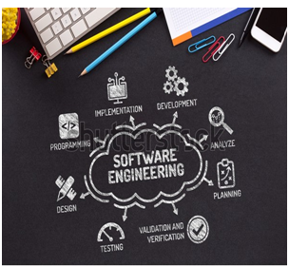

BCAC0010: System Design & Software Engineering

Slide 2


The Incremental Model or Iterative Enhancement Model:-
Generally the phases occur in the same order as in the waterfall model but they may conducted in the several cycles.
A usable product is released at the end of each cycle.
With each release providing additional functionality therefore every iteration would therefore deliver a product with incremental capabilities.

Slide 3

Iterative model deliver and operation quality product at each release but one that satisfies only a subset of the customer requirements.
The complete product is divided into releases and the developer deliver the product release by release.

Slide 4
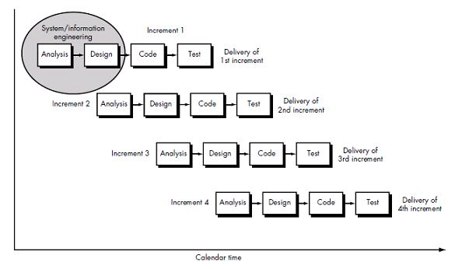

Slide 5
Advantages:-
It is particularly useful when staffing is unavailable for a complete implementation. Early increment can be implemented with fewer people if the core product is well received then additional staff can be added.
2) this approach also has advantages specially for in- house development where it is ensure that the user has something to start with.

Slide 6

Disadvantages:-
The potential danger of this method is that the iteration may never end and the user may never really get the final product.
2) another problem with this type of project comes in generating the business contract i.e how with the cost of additional features being determined and negotiated.

Slide 7
Prototyping model
A prototyping model suggest that before development of the actual software a working prototype of the system should be build first.
A prototype means a sample or we can say that toy implementation of a system.
Prototyping is a technique that allows for a reduced functionality or limited performance of the software to be delivered to the user in the early stages of the development process.
This approach helps to solidify users requirements earlier thereby making waterfall approach more effective.

Slide 8
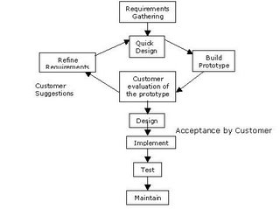

Slide 9
Prototyping is particularly useful in the development of very large system where it is difficult to describes all the requirements and it also helps to examine the technical issues associated with the product development.
This model begins with the requirement gathering. Developers and customers meet and define the overall objectives for the software, identify whatever requirements are known and outline areas where further definition is compulsory.
A quick design then occur it focuses on a representation of these aspects of the software that will be visible to the user.

Slide 10

Advantages of Prototyping model:-
It provides better understanding of the customer needs.
It helps to examine the technical issues associated with the product development.
This method is useful in the development of very large system.
It solidify user requirements thereby making the waterfall approach more effective.

Slide 11
Disadvantages of Prototyping model:-
In some cases, prototype has to be discarded
because some might argue that the cost involved
is higher.
Use of inefficient, inaccurate, or dummy function
may not provide the actual processing.
The developer often makes implementation
compromises, in order to get a prototype working
quickly.

